Slide 1
Lubridate R Package
Satyen Amonkar
IST 719

Slide 2

Importance of Lubridate Package
Converting string to date is a tedious task in R especially when the standard format of R is not known
as.Date() function can be used to convert string to date in R
However, the input function has to be Year-Month-Date format (2019-01-20), else it throws error
Lubridate is an R package that makes it easier to work with dates and times
Notes:
(easy to use and grasp)

Slide 3
Common Applications of Lubridate Package
Parsing dates and times
Setting and Extracting information
Instants
Time Zones
Timespans
Arithmetic with date times

Slide 4
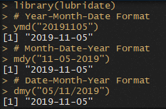
Fast Parsing of data and times
Lubridate simplifies the function name of date formats:
Identify order of year, month and day that appears in the dates
Arrange “y”, “m”, and “d” in the same order
This is the name of the function in Lubridate that will parse your dates

Slide 5
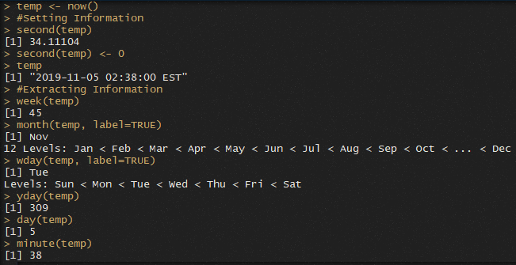
Setting and Extracting information
Information can be extracted from date time functions:
second, minute, hour, day, week, month, year, wday, yday and tz
month and wday functions have an optional argument called label, which replaces the numeric output to weekday or month

Slide 6
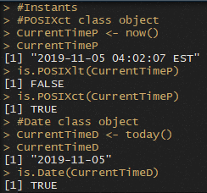
Instants
Instants are specific moments of time.
Date, POSIXct, and POSIXlt are its three object classes

Slide 7
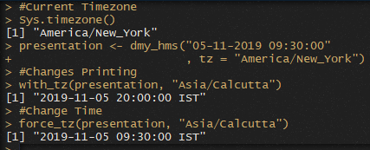
Time Zones
Lubridate provides two helper functions for working with time zones.
with_tz: changes the time zone in which an instant is displayed. The clock time displayed for the instant changes, but the moment of time described remains the same
Force_tz: changes only the time zone element of an instant. The clock time displayed remains the same, but the resulting instant describes a new moment of time

Slide 8
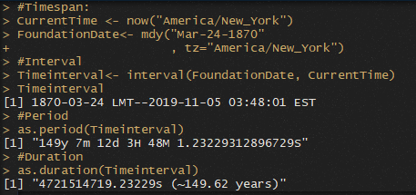
Timespans
Lubridate provides three additional classes to better navigate nuances of time:
Interval: summary of the time information between two points
Period: accurately track clock times despite leap years, leap seconds, and day light savings time
Duration: measure the exact amount of time between two points

Slide 9
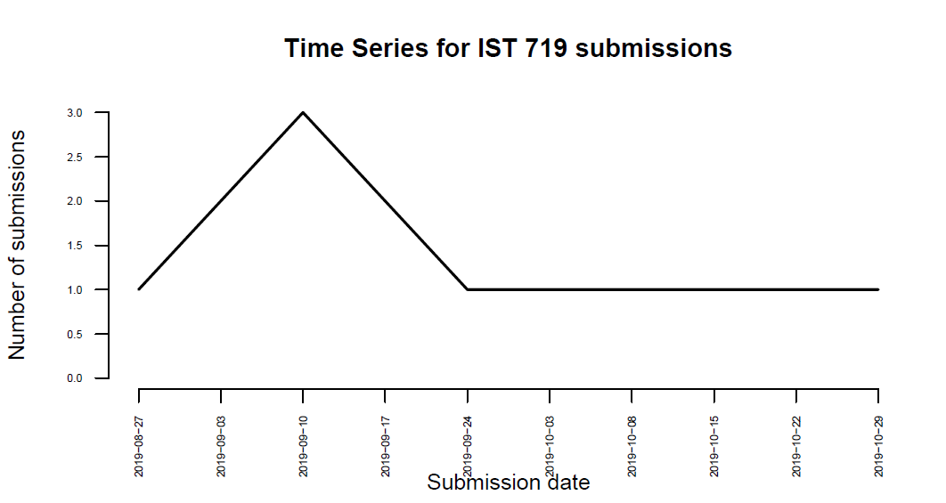
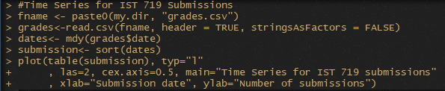
Time Series for IST 719 Graded Submissions

Slide 10
Thank You!
Satyen Amonkar

